Slide 1
Group 2 Project Presentation

Slide 2
Project Objective
Our goal was to identify trends of food purchases relative to recipe searches, trends in food delivery services and general trends in eating in vs. dining out in the US.
The main questions we wanted to address were:
What are the broad trends in grocery/food store sales vs. restaurant/dining sales during 2020 vs. longer periods of time?
Was there evidence to support these trends on an individual company basis?
Was there any relationship between grocery sales trends and restaurant search data?
Was there any relationship between food delivery service data and grocery sale trends?

Slide 3
Sources of Data
USDA
US Census Bureau
SEC public filings
Yelp.com
Any others?

Slide 4
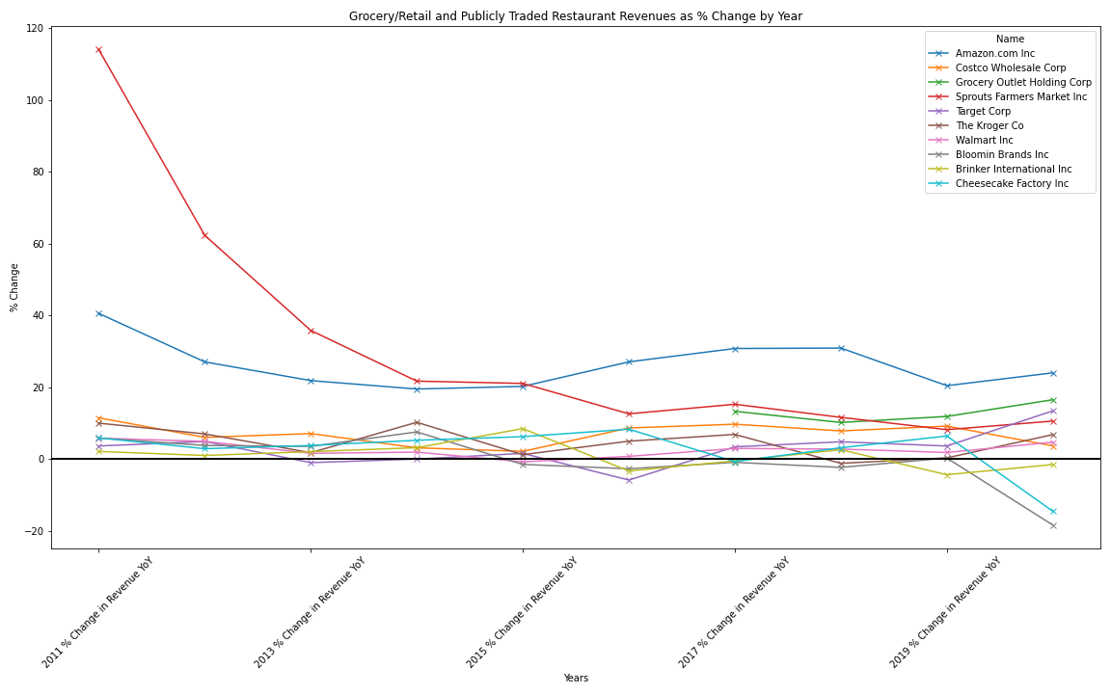
Individual Company Trends
I chose several publicly traded grocery chains (Kroger, Sprouts Farmers Market, Grocery Outlet), large multi-channel retailers (Costco, Target, Walmart) and Amazon, as they acquired Whole Foods several years ago.
I also chose 3 publicly traded restaurant chains, Bloomin Brands (Outback, Carrabba’s, Bone Fish Grill, Fleming’s), Brinker International (Chili’s and Maggiano’s) and Cheesecake Factory.
After compiling the data into a .csv file, I brought the data into a dataframe in pandas and began to clean the formatting.
To estimate full year 2020 revenue data, since most companies have not announced their earnings data yet, I had to make a pro-forma estimate of full year 2020 revenue using TTM revenue numbers and then projecting using Q1 – Q3 revenue numbers which gave me a rough estimate for what Q4 would look like and then rolled all four quarters into an annual estimate for 2020.
After cleaning the revenue data, I made a calculation for the percentage change year over year and created a new dataframe with that information.
Lastly, I plotted the year over year percentage change in revenue to visualize the data graphically, focusing on the divergence between grocers and publicly traded restaurants. As you can see, many of the grocers maintained or actually grew their revenues faster than they had on a trending basis, while the publicly traded restaurant revenues fell off a cliff in 2020.

